Slide 1
Knowledge
Ruby is coming into focus
Rake is a hand “task master”
Rspec intrigues

Slide 2
Status
Card, Deck, Hand objects are working
Game is in process
Can ask a hand for a card
Working on play_round
Next Steps:
Complete basic non-server game play
Adapt for interaction from a terminal
Basic server development
Basic client development
Refine and expand

Slide 3
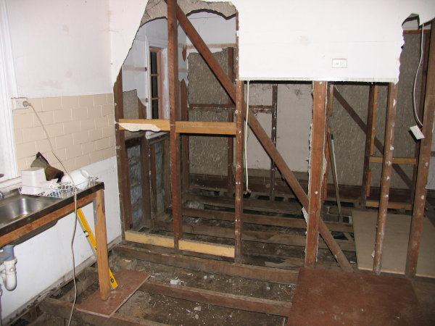
Understanding
Application Development requires new thinking
Old thinking takes some effort to remove.

Slide 4
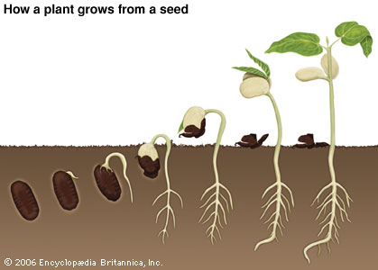
Greg feels like he’s here
He is probably here
Learning is like growing: a lot goes on before the fruit appears

